Slide 1
Luca Pietrobon
Propose a project for The Data Incubator
Feb 16, 2016

Slide 2
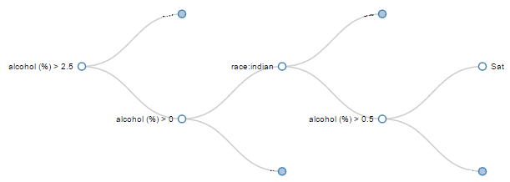
The idea
Personalized prediction
Change your destiny

Slide 3
Prediction strategies
Level 1
Level 2
Level 3
Random Guess
Given N possible categories, (uniformly) pick one at random
Pick the most frequent
Look at the statistical distribution and guess for the most frequent category
Decision Tree
Train a Classifier on the dataset and use it to make predictions

Slide 4
Prediction strategies
Level 1
Level 2
Level 3
Random Guess
Given N possible categories, (uniformly) pick one at random
Pick the most frequent
Look at the statistical distribution and guess for the most frequent category
Decision Tree
Train a Classifier on the dataset and use it to make predictions
Accuracy
1 / N
Accuracy
Normalized_frequency
Accuracy
Classifier.score()
≤
≶

Slide 5
Prediction strategies
Level 1
Level 2
Level 3
Random Guess
Given N possible categories, (uniformly) pick one at random
Pick the most frequent
Look at the statistical distribution and guess for the most frequent category
Decision Tree
Train a Classifier on the dataset and use it to make predictions
Accuracy
1 / N
Accuracy
Normalized_frequency
Accuracy
Classifier.score()
≤
≶
Guessing power = Classifier.score() / Normalized_frequency

Slide 6
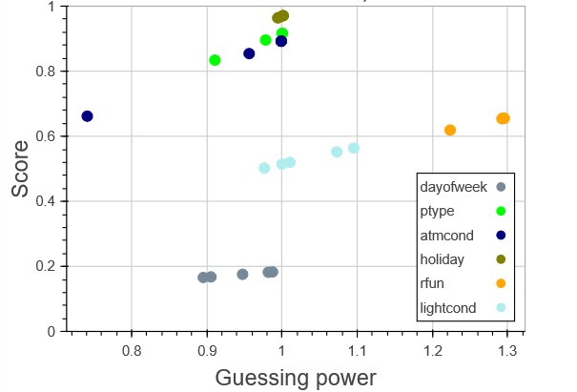
Assessing the classifier

Slide 7
Assessing the classifier
Level 2 most frequent category | Level 3 use Classifier and predict category
GuessingPower = | Classifier.score()
 | frequency_of_most_frequent

Slide 8
Assessing the classifier

Slide 9
Assessing the classifier
Improvements:
Larger dataset
DataFrame.to_sparse()
SelectPercentile
Remove correlated
Reduce cardinality

Slide 10
Assessing the classifier

Slide 11
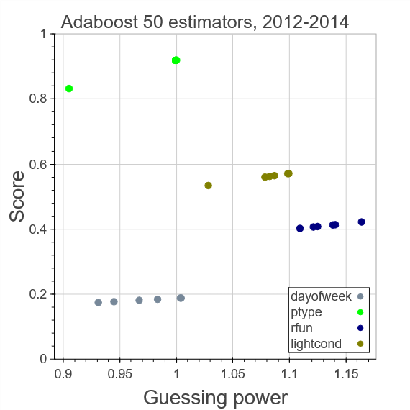
Collapsing categories
Ptype:
[‘motor’, ‘non_motor’]

Slide 12
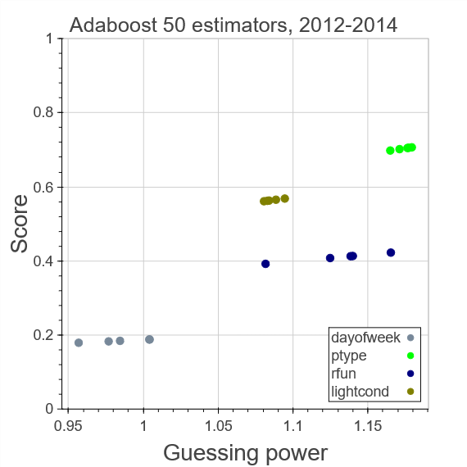
Collapsing categories
Ptype:
[‘motor’, ‘non_motor’]
Ptype:
[‘Driver’, ‘Passenger’, ‘Pedestrian/Cyclist’]

Slide 13
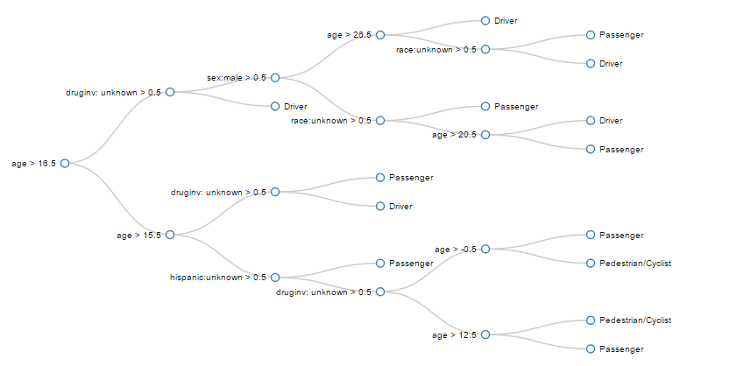
Output

Slide 14
The solution
How to make it better
- GEO info (city, county, coordinates)
- Cardinality studies
- Account for probability of getting involved in accident
- Different database: accidents without fatalities
Classification is helpful on selected features
(and smart categorization)

Slide 15
